Slide 1

The evolution of Hip-Hop over the years
Data Visualization
Aglind Reka
Hed Derbel
Youssef Bouchida
Paul Peyssard
MSc Data Science & Artificial Intelligence

Slide 2
Summary
Introduction
Group Work (WorkFlow)
Fetching the Data
Cleaning the Data
Personal Parts
Conclusion

Slide 3
Introduction
Main idea : The evolution of Hip Hop.
Different types of Evolution

Slide 4
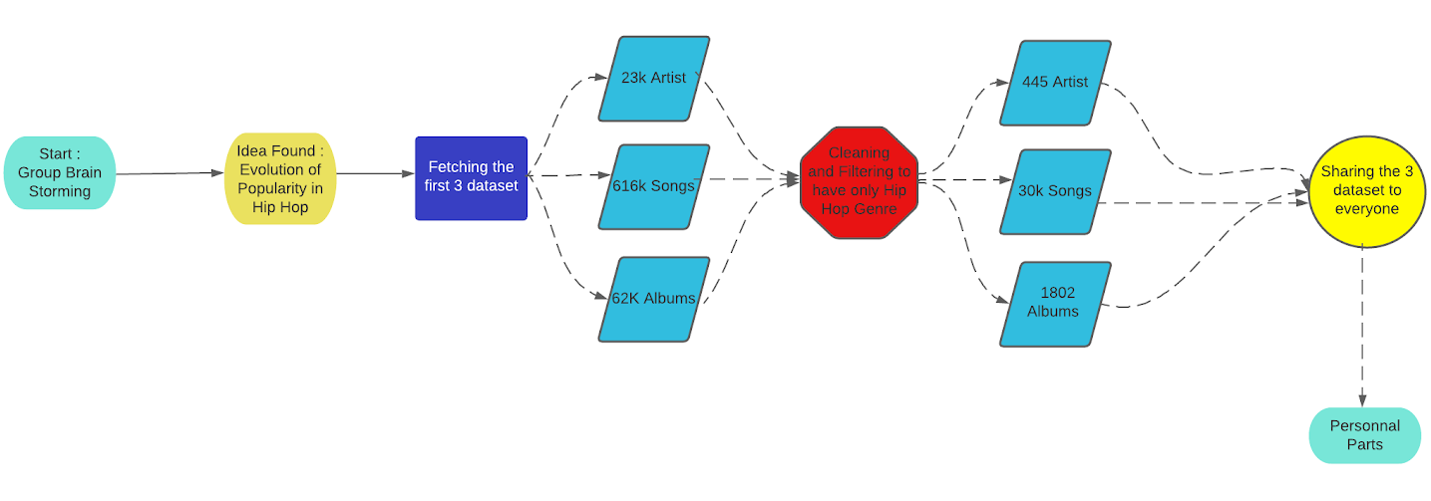
Group Work

Slide 5

Fetching the data

Slide 6
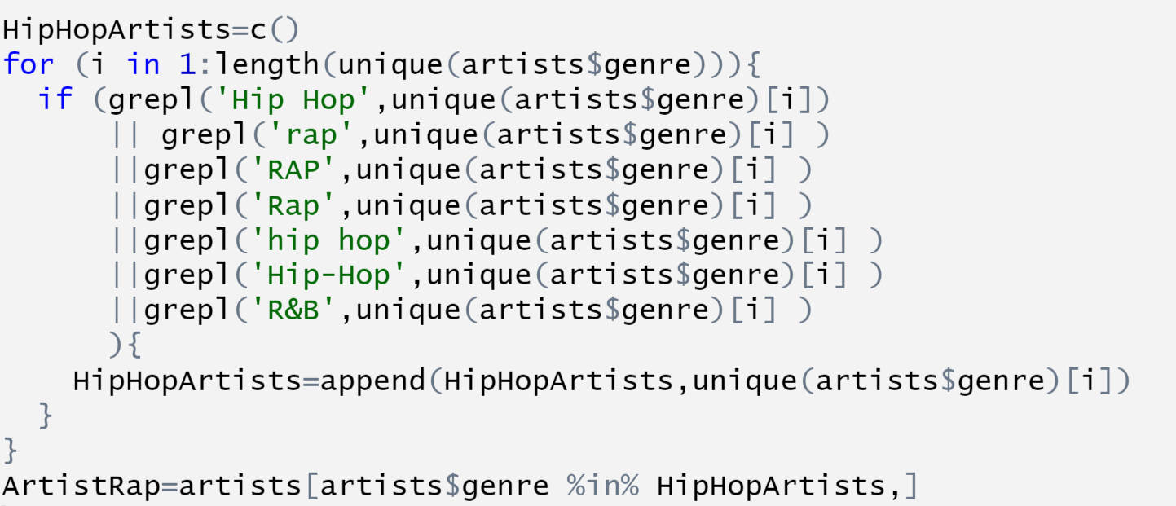
Cleaning the data

Slide 7
Evolution of Popularity in Hip Hop
Popularity in terms of rank
Popularity in terms of Deezer Fans
Comparison between gender

Slide 8
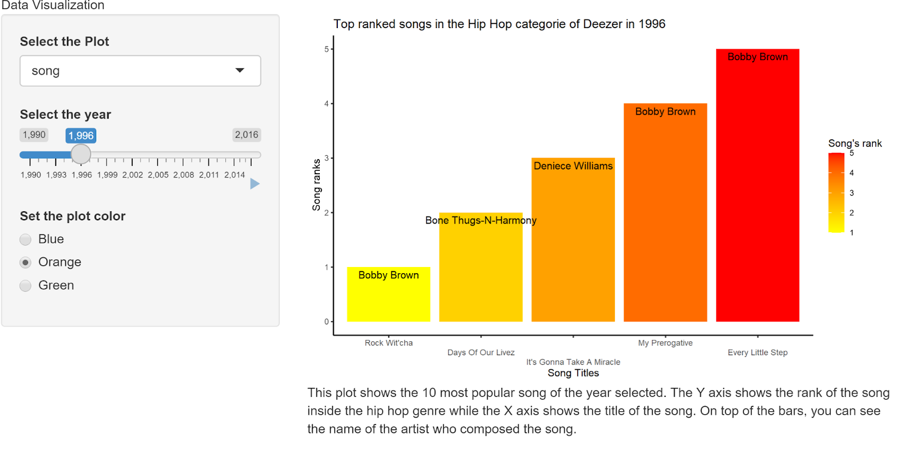
First Plot : Popularity (rank) of songs

Slide 9
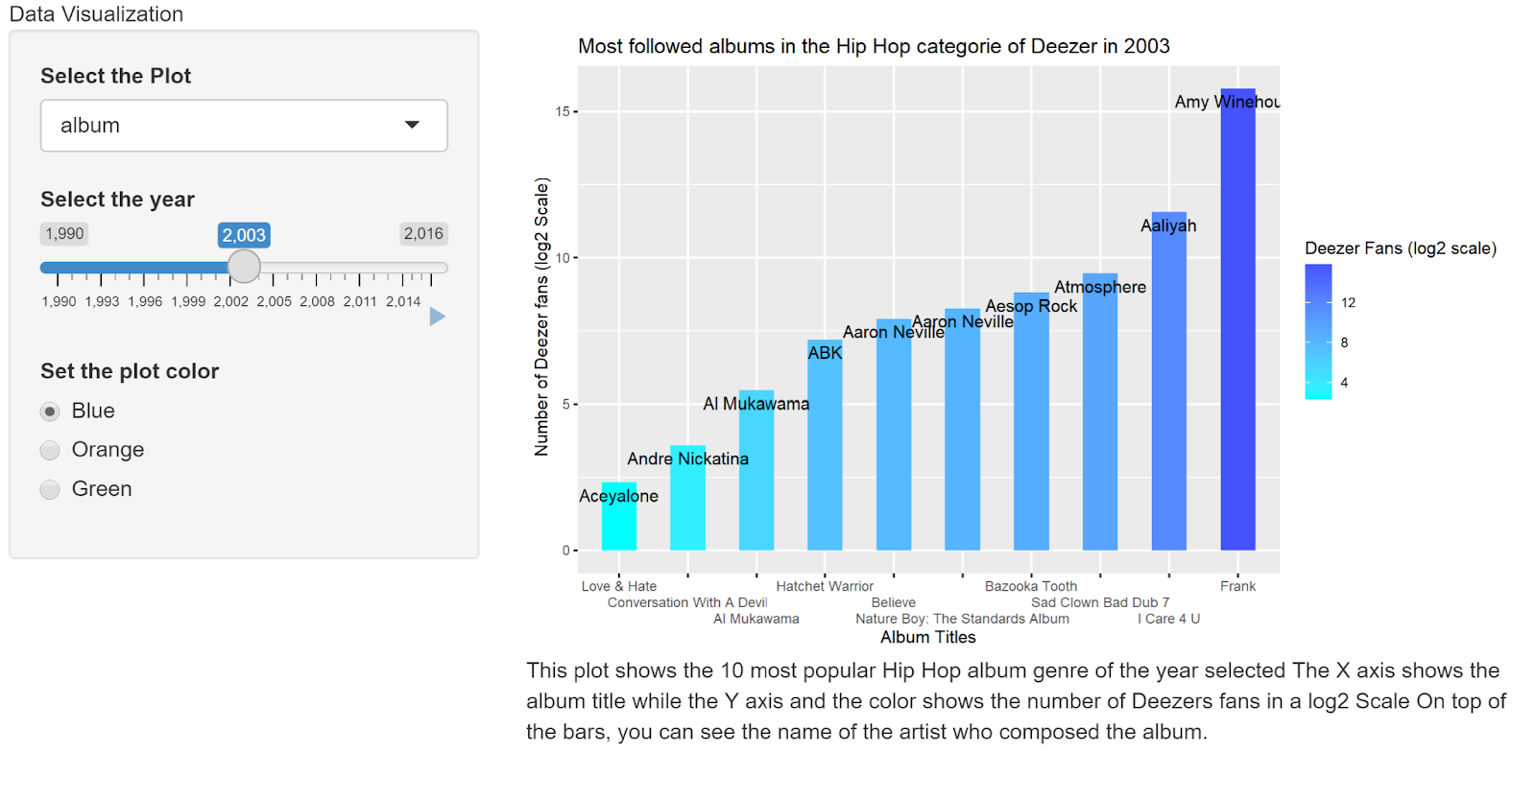
Second Plot : Popularity (Deezer Fans) of Albums

Slide 10
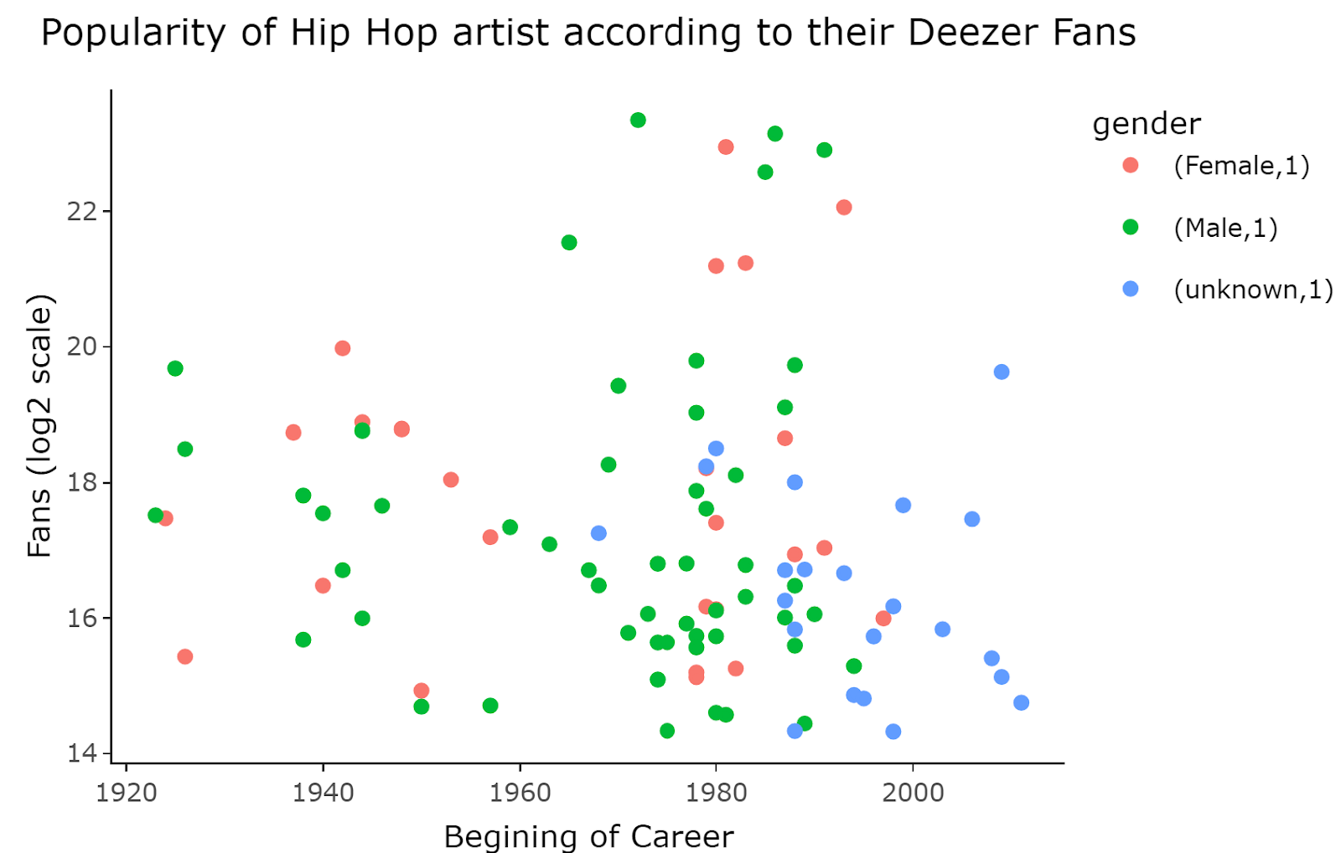
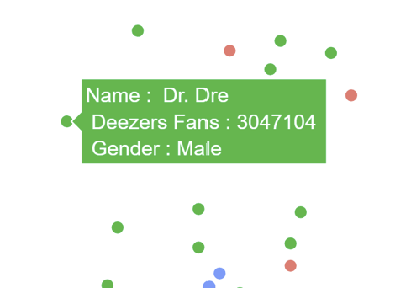
Third Plot : Comparison of popularity (Deezer Fans) of artists between gender

Slide 11
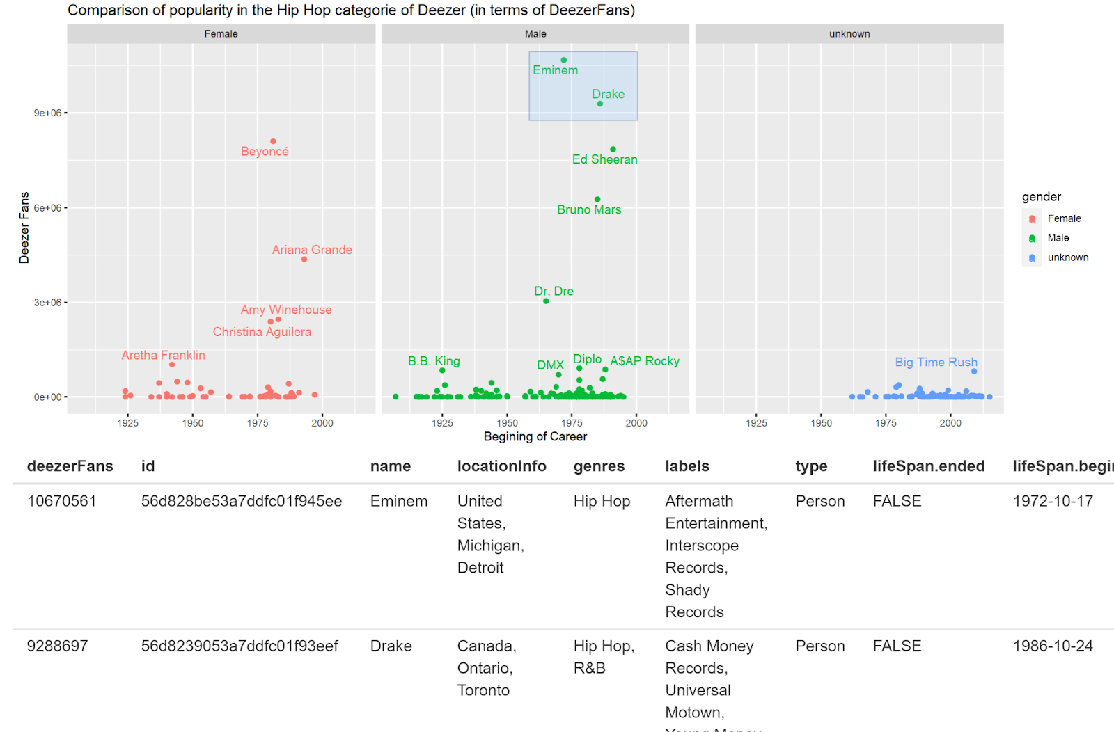
Fourth plot : Interactive plot and table of popularity (Deezer Fans) between gender

Slide 12
Evolution of Popularity in Hip Hop
Popularity of artists in terms for Deezer fans
Popularity of artists per country
Popularity of albums in a certain date range

Slide 13
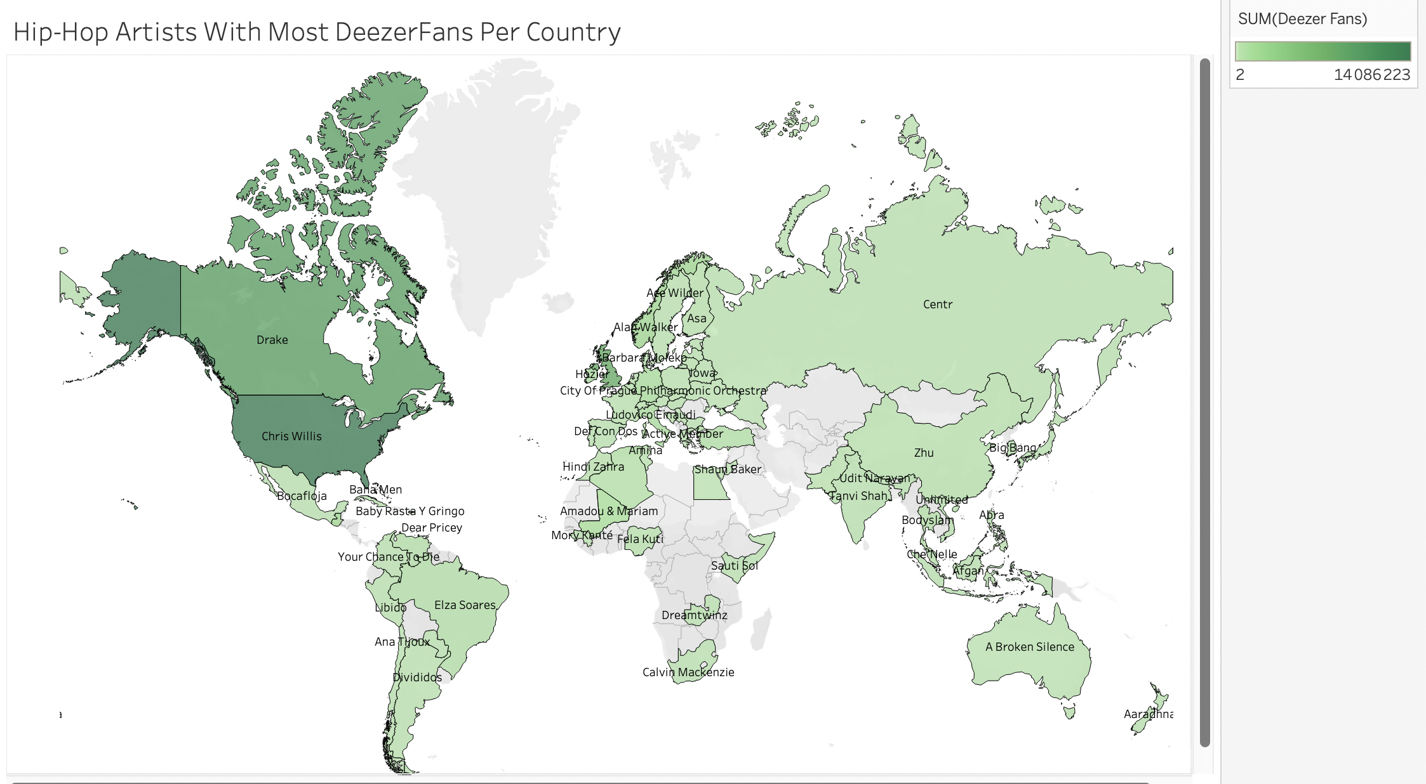
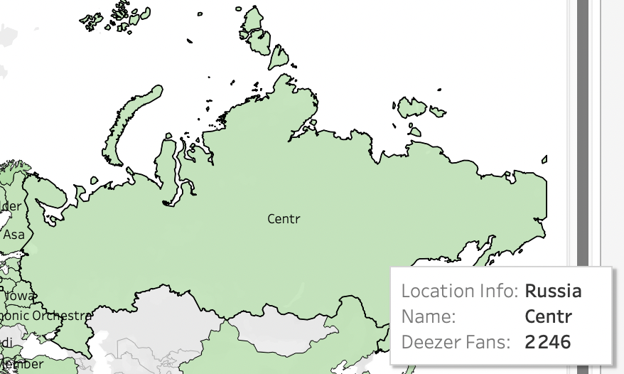
First Plot : Hip-Hop Artists With Most Deezer Fans Per Country

Slide 14
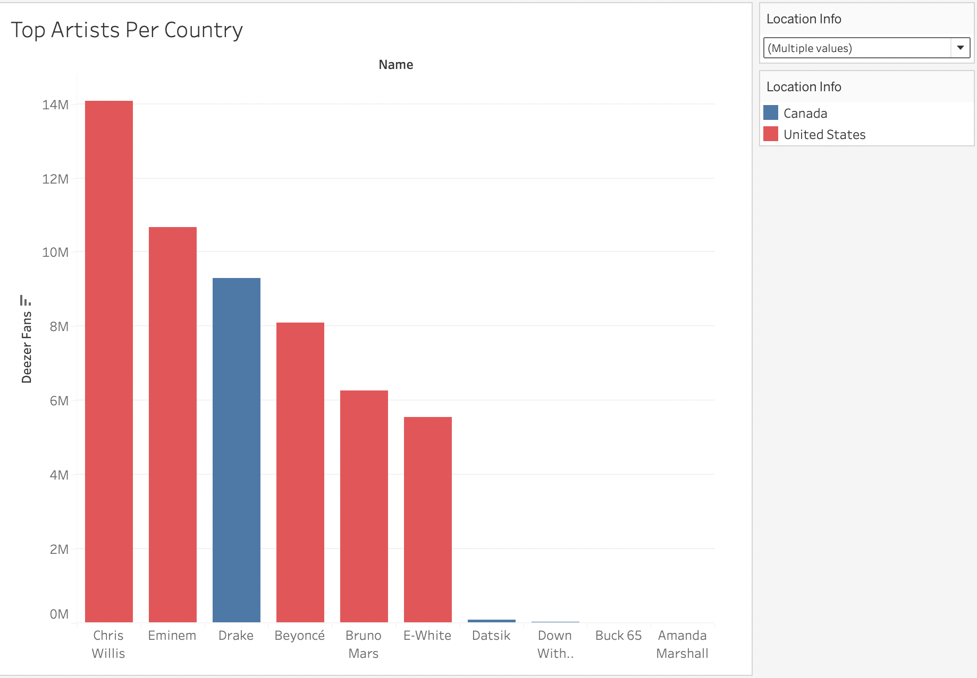
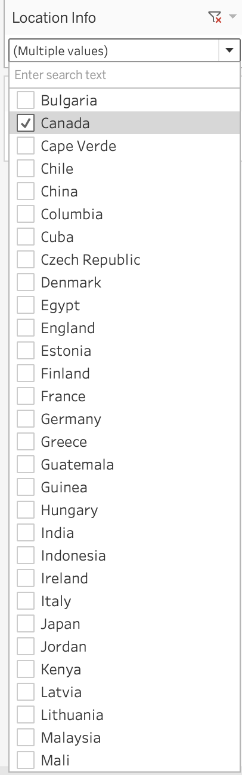
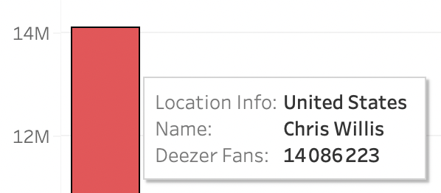
Second Plot : Top Artists Per Country

Slide 15
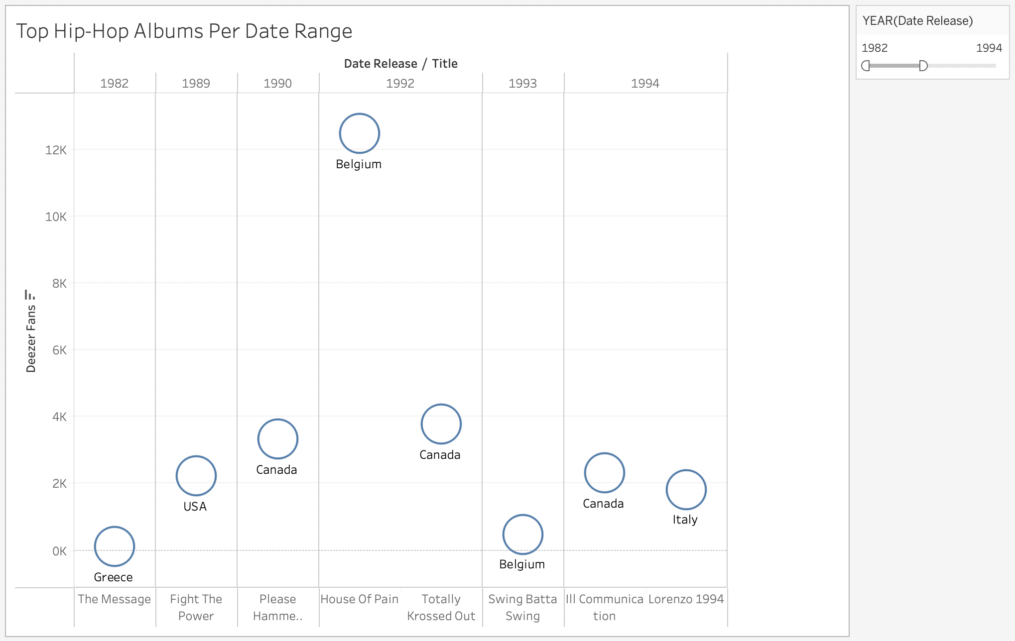
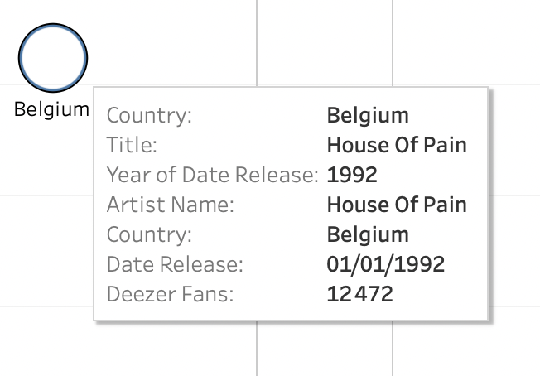
Third Plot : Top Hip-Hop Albums Per Date Range

Slide 16
Hip-Hop Albums Per Date and Country
AGLIND REKA

Slide 17
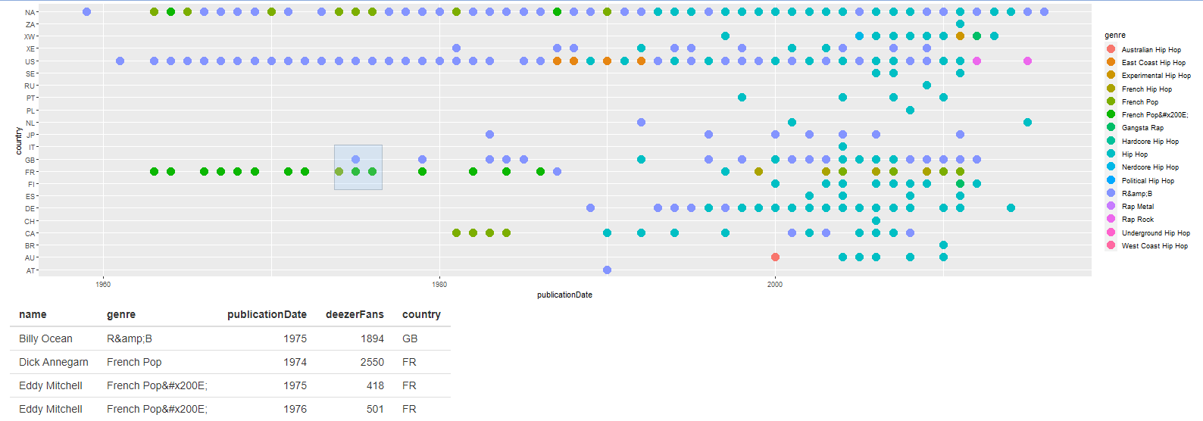
Hip-Hop Albums Per Date and Country

Slide 18
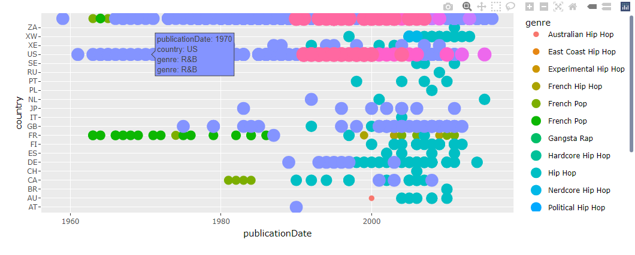
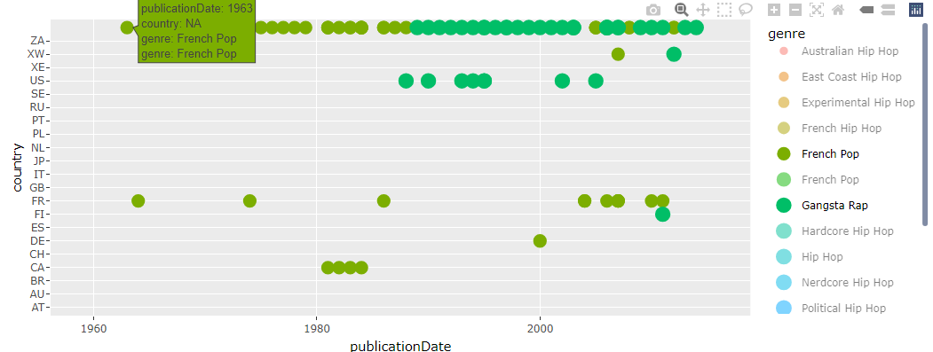
Hip-Hop Albums Per Date and Country

Slide 19
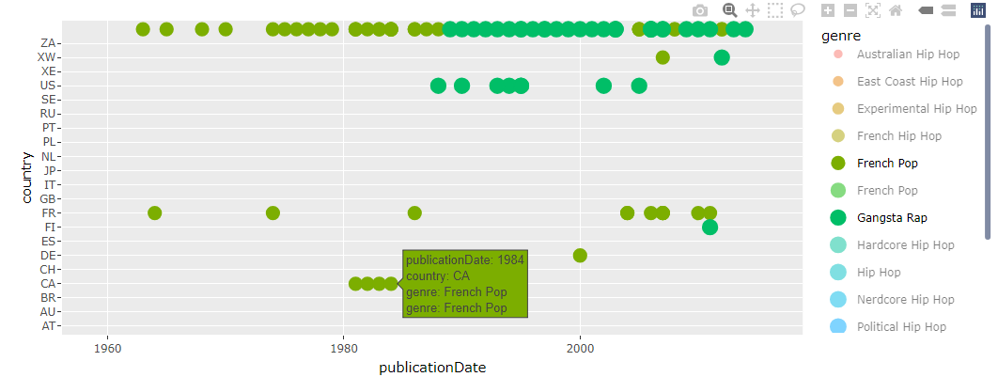
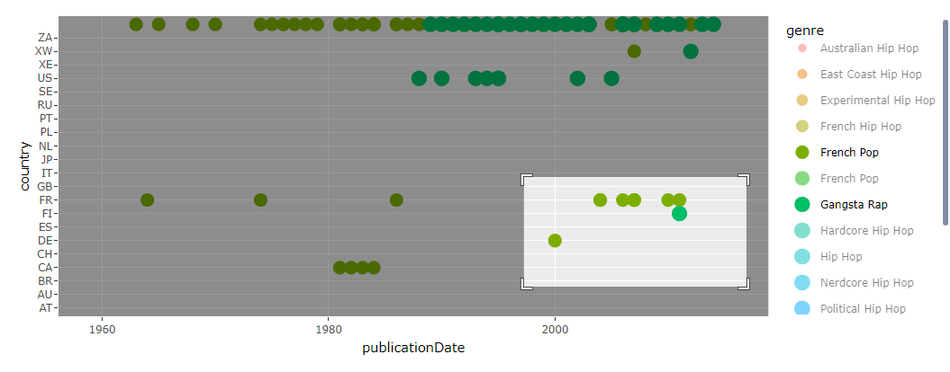
Hip-Hop Albums Per Date and Country

Slide 20
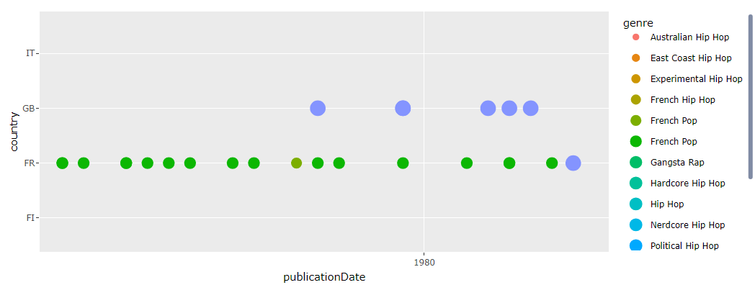

Slide 21
Evolution of Popularity in Hip Hop
Popularity of Hip-Hop albums among the other music genres
Progress of released Hip-Hop albums from 1985 to 2015

Slide 22
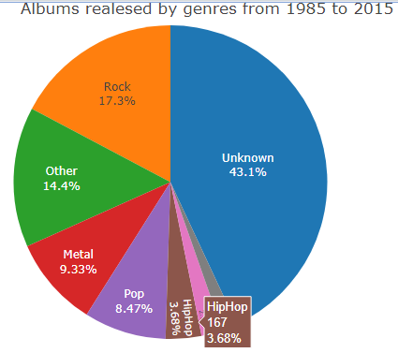
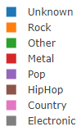
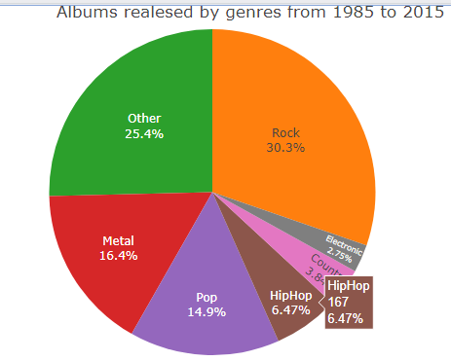
First Plot : Popularity of Hip-Hop albums among the other music genres

Slide 23
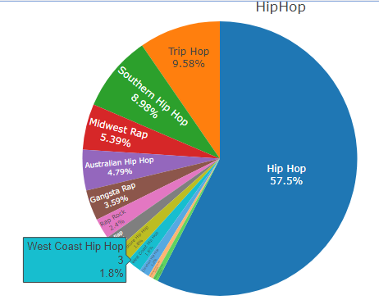
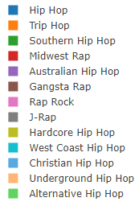
First Plot : Popularity of Hip-Hop albums among the other music genres

Slide 24
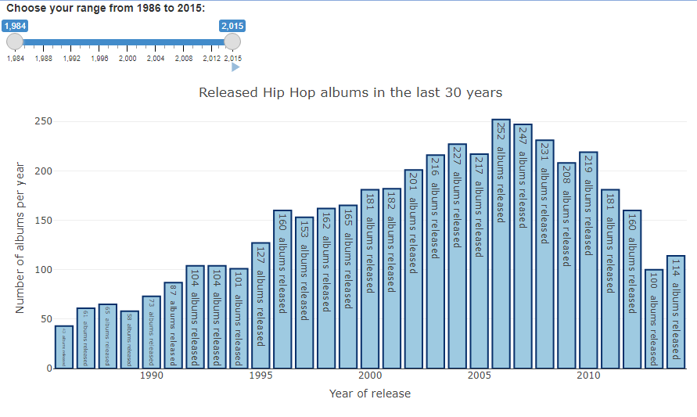
Second Plot : Progress of released Hip-Hop albums from 1985 to 2015

Slide 25
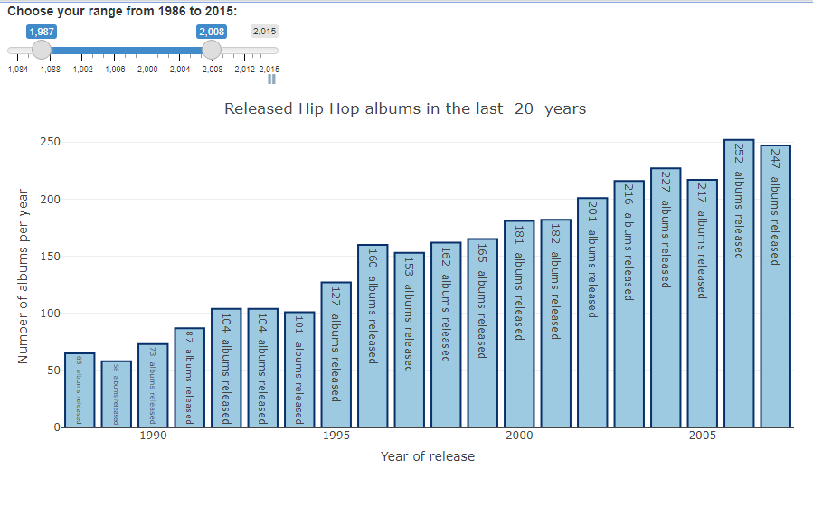
Second Plot : Progress of released Hip-Hop albums from 1985 to 2015

Slide 26
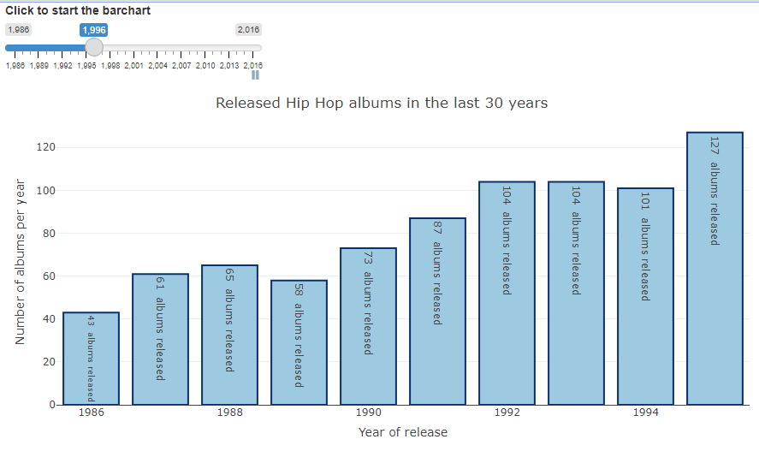
Second Plot : Progress of released Hip-Hop albums from 1985 to 2015

Slide 27
Conclusion

